Slide 1
12 – Discriminant Functions
Dave Eargle – CU Boulder

Slide 2
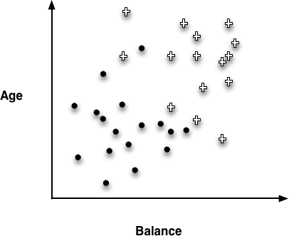
Instance Space
What other kind of decision boundary might we use to separate our data, besides perpendicular lines?
25 30 35 40 45 50 55
10k 20k 30k 40k 50k 60k 70k 80k 90k 100k

Slide 3
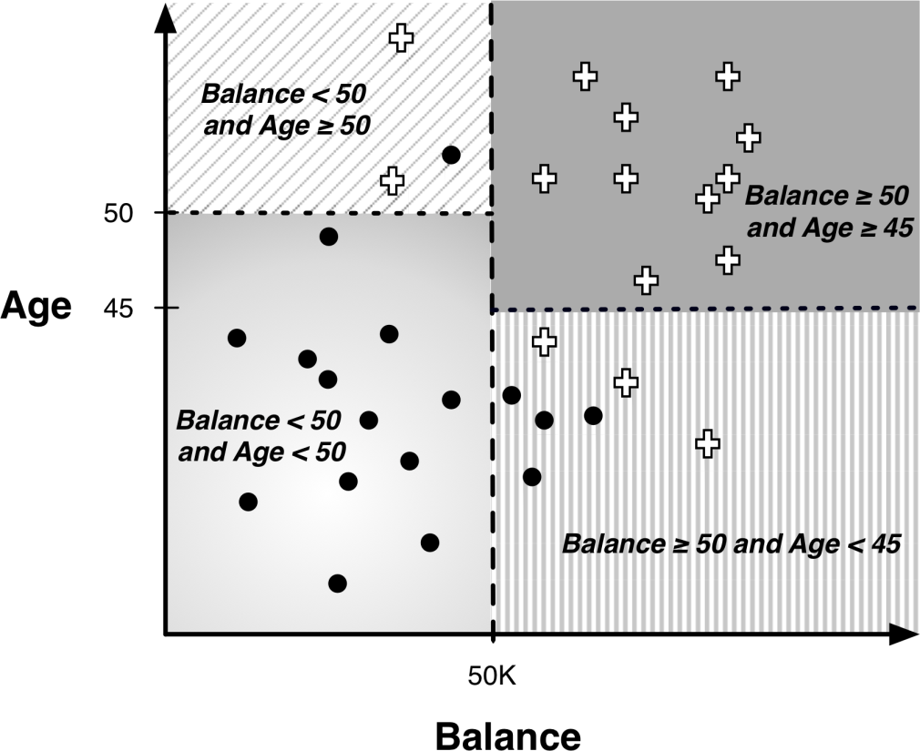
Decision Boundaries -- supervised segmentation example
How else can we classify besides a tree?
Decision trees result in “decision boundaries” that are perpendicular to axes.

Slide 4
Instance Space
What other kind of decision boundary might we use to separate our data, besides perpendicular lines?

Slide 5
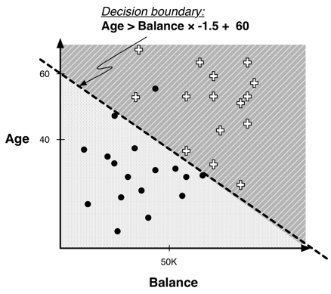
Linear Classifier
Find a straight line that best separates the points. Classification depends on which side of the line the points fall on.

Slide 6
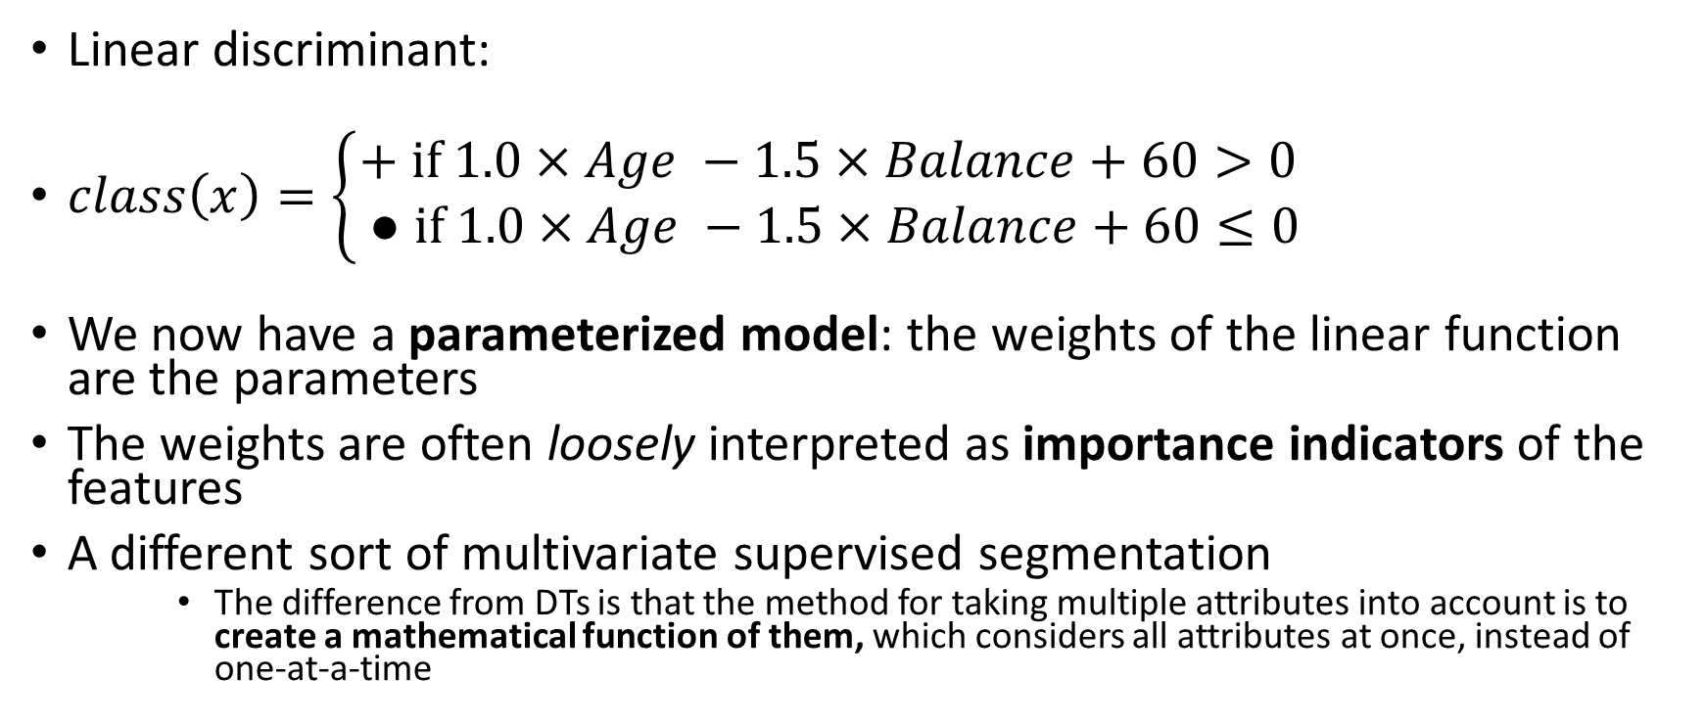
Example of Classification Function
Linear discriminant:
$class\left(x\right)=\left\{\begin{aligned}+ \text{if} 1.0×Age −1.5×Balance+60>0 \\ ● \text{if} 1.0×Age −1.5×Balance+60≤0\end{aligned}\right.$
We now have a parameterized model: the weights of the linear function are the parameters
The weights are often loosely interpreted as importance indicators of the features
A different sort of multivariate supervised segmentation
The difference from DTs is that the method for taking multiple attributes into account is to create a mathematical function of them, which considers all attributes at once, instead of one-at-a-time

Slide 7
What if we want a likelihood of class membership? How can we quantify that?
“The farther away from the line, the more likely the corresponding class”?
We need a function that can predict probability…
Some predictor that gives us an estimate between 0 and 1…
Keep in mind over the next slides that the goal is to predict probability

Slide 8
A simpler case (one independent variable)
Estimate the probability of membership in class 1
1
Class
0
50K
Balance
Bad risk (Default) – 16 cases
Good risk (Not default) – 14 cases

Slide 9
A simpler case (one independent variable)
Could we maybe say that the farther from the line the more likely the corresponding class?
Estimate the probability of membership in class 1
Can we use linear regression to estimate the probability?
1
Class Probability
0.5
Does a probability >1 or < 0 make sense?
0
50K
Balance
No!
Bad risk (Default) – 16 cases
Good risk (Not default) – 14 cases

Slide 10
A simpler case (one independent variable)
Could we maybe say that the farther from the line the more likely the corresponding class?
Estimate the probability of membership in class 1
Can we use linear regression to estimate the probability?
1
Class Probability
0.5
Does a probability >1 or < 0 make sense?
0
50K
Balance
No!
We need a squiggly line!
Bad risk (Default) – 16 cases
Good risk (Not default) – 14 cases

Slide 11
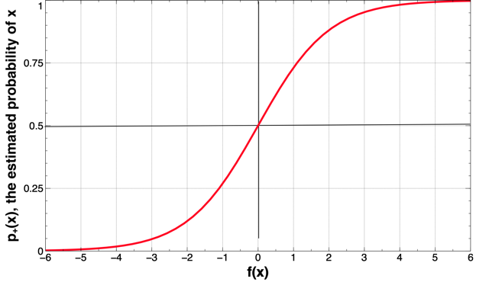





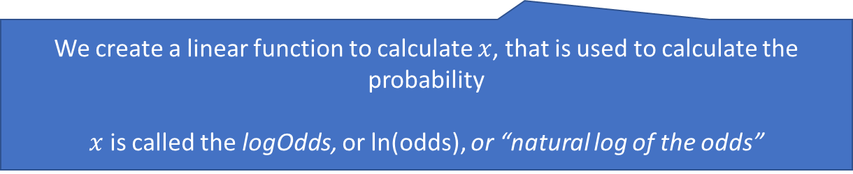
Logistic regression (“sigmoid”) curve
“sigmoid” curve – a line with min:0 and max:1
$p_{+}\left(y\right),$ the estimated probability of y
$$f\left(x\right)=\frac{1}{1+e^{−x}}=\frac{e^{x}}{e^{x}+1}$$
$$f\left(x\right)=probability$$
$$x=logOdds$$
$$e^{logOdds}=odds$$
What are “odds”?
x
We create a linear function to calculate $x$, that is used to calculate the probability
$x$ is called the logOdds, or ln(odds), or “natural log of the odds”

Slide 12
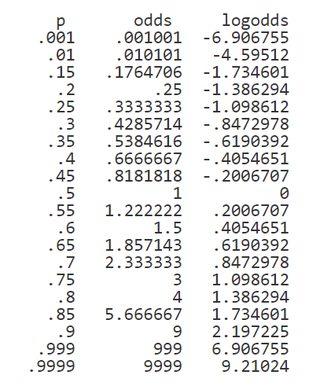
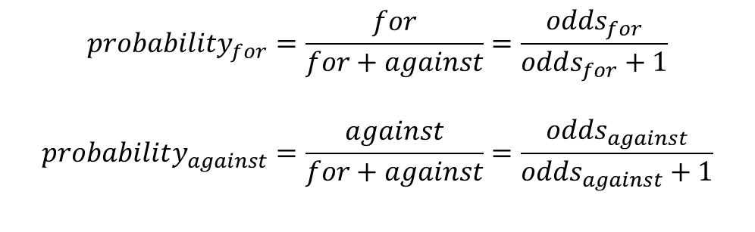
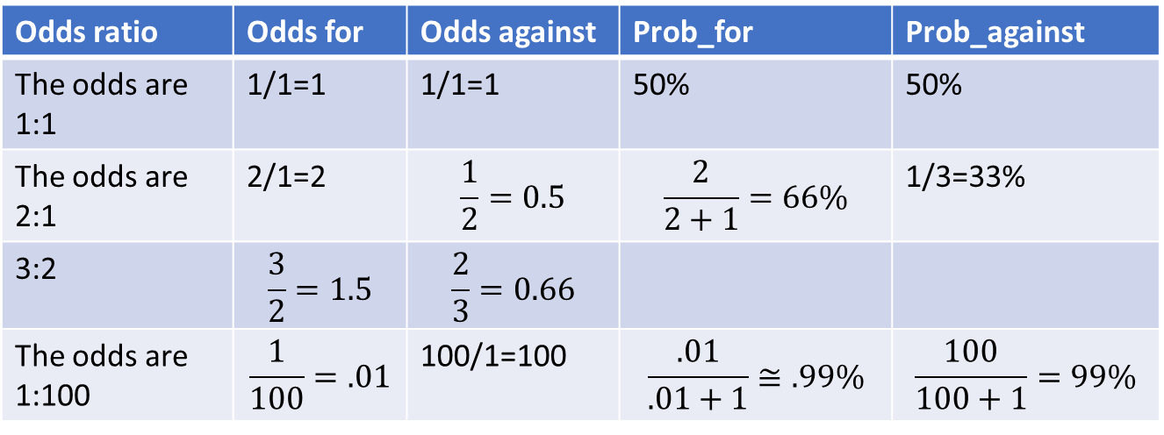
Probability, odds, and logOdds
Odds are familiar to gamblers.
Odds ratio | Odds for | Odds against | Prob_for | Prob_against
The odds are 1:1 | 1/1=1 | 1/1=1 | 50% | 50%
The odds are 2:1 | 2/1=2 | $$\frac{1}{2}=0.5$$ | $$\frac{2}{2+1}=66\%$$ | 1/3=33%
3:2 | $$\frac{3}{2}=1.5$$ | $$\frac{2}{3}=0.66$$
The odds are 1:100 | $$\frac{1}{100}=.01$$ | 100/1=100 | $$\frac{.01}{.01+1}≅.99\%$$ | $$\frac{100}{100+1}=99\%$$
$$probability_{for}=\frac{for}{for+against}=\frac{odds_{for}}{odds_{for}+1}$$
$$probability_{against}=\frac{against}{for+against}=\frac{odds_{against}}{odds_{against}+1}$$

Slide 13
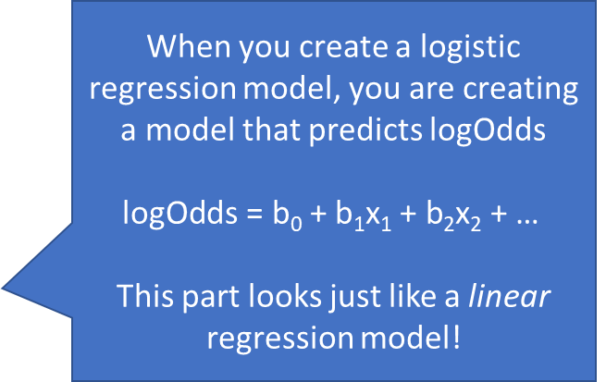



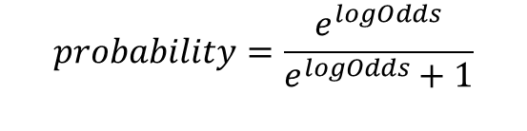

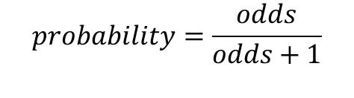

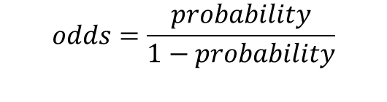
Logistic regression (“sigmoid”) curve
$$probability= \frac{1}{1+e^{−(b0 + b1x1 + b2x2 + …)}}$$
When you create a logistic regression model, you are creating a model that predicts logOdds
$$\text{logOdds}\text{ = }\text{b}\text{0}\text{ + }\text{b}\text{1}\text{x}\text{1}\text{ + }\text{b}\text{2}\text{x}\text{2}\text{ + … }$$
This part looks just like a linear regression model!
$$f\left(x\right)=probability= \frac{1}{1+e^{−x}}=\frac{e^{x}}{e^{x}+1}$$
$p_{+}\left(y\right),$ the estimated probability of y
$$probability=\frac{odds}{odds+1}$$
$$probability=\frac{e^{logOdds}}{e^{logOdds}+1}$$
x
$$e^{logOdds}=odds$$
Relationship between logOdds and probability
$$x=logOdds$$
$$odds=\frac{probability}{1−probability}$$

Slide 14
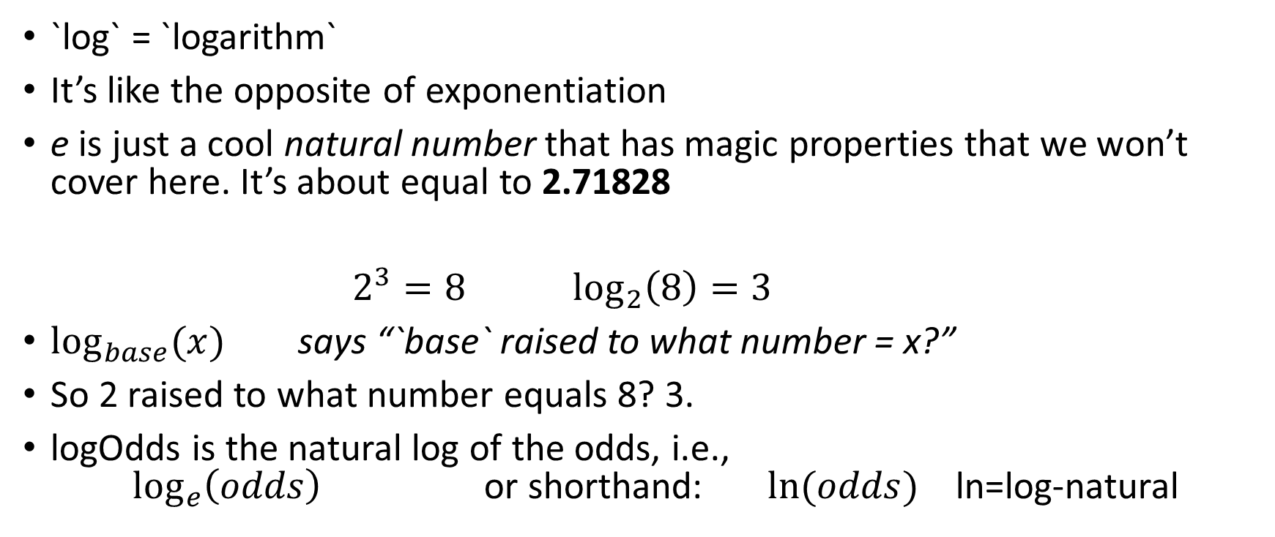
What is a `log” again? And what is e?
`log` = `logarithm`
It’s like the opposite of exponentiation
e is just a cool natural number that has magic properties that we won’t cover here. It’s about equal to 2.71828
$2^{3}=8$ $\log_{2}\left(8\right)=3$
$\log_{base}{(x)}$ says “`base` raised to what number = x?”
So 2 raised to what number equals 8? 3.
logOdds is the natural log of the odds, i.e., $\log_{e}\left(odds\right)$ or shorthand: $ln⁡(odds)$ ln=log-natural

Slide 15
Why a function to predict `logOdds`? Why not `odds`?
Probability is in the range of (0,1)
But linear regression functions model [-infinity, +infinity]
Odds are bound between (0, infinity], so can’t use that
but… logOdds have a range of [-infinity, +infinity]
So… model logOdds, then switch back to probability!
Tada!

Slide 16
Logistic regression is a misnomer
The distinction between classification and regression is whether the value for the target variable is categorical or numeric
For logistic regression, the model produces a numeric estimate
However, the values of the target variable in the data are categorical
Logistic regression is estimating the probability of class membership (a numeric quantity) over a categorical class
Logistic regression is a class probability estimation model and not a regression model

Slide 17
So now you are proficient with logistic regression
And how to use it to get a classification probability depending on how close to a line a point falls

Slide 18
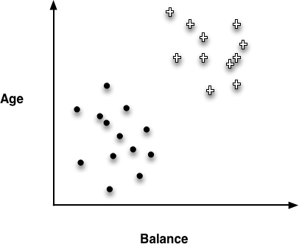
So where should we draw the line of discrimination?

Slide 19
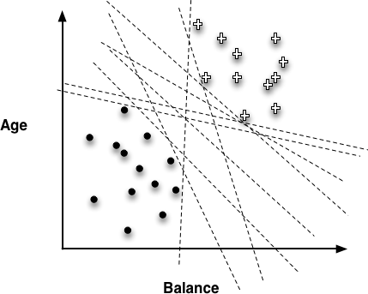
ANSWER ME. WHICH LINE IS BEST
All of these lines are perfect classifiers. But intuitively, where is the best place to draw the line? Which Why?

Slide 20
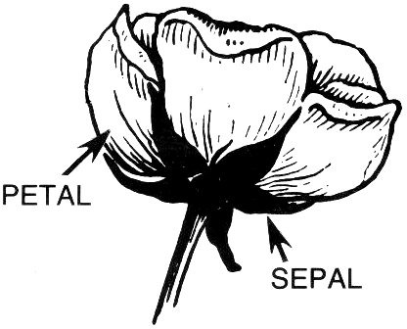
Let’s classify some flowers

Slide 21
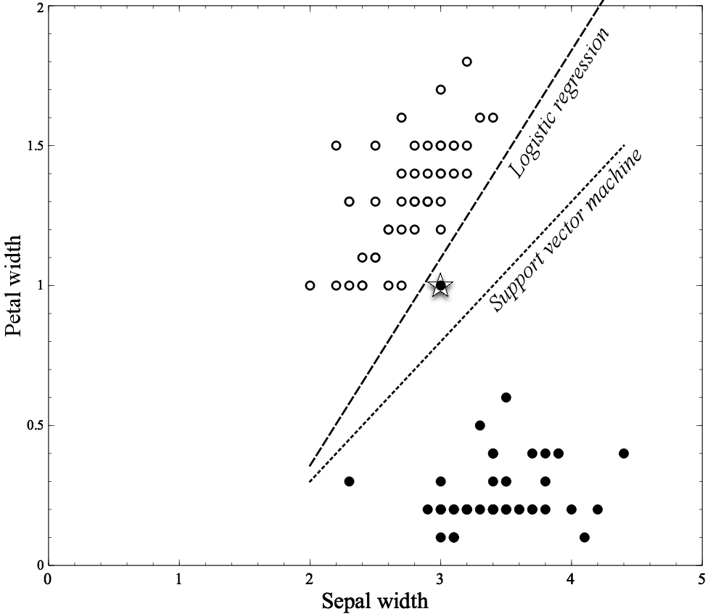
Classifying Flowers
Why did the logistic regression model put the boundary here?
Where would be a better place for it?

Slide 22
Classifying Flowers
SVM put the line here. Much less prone to overfitting. How does it look like it decided to put the line here?
What is SVM? Let’s find out…

Slide 23
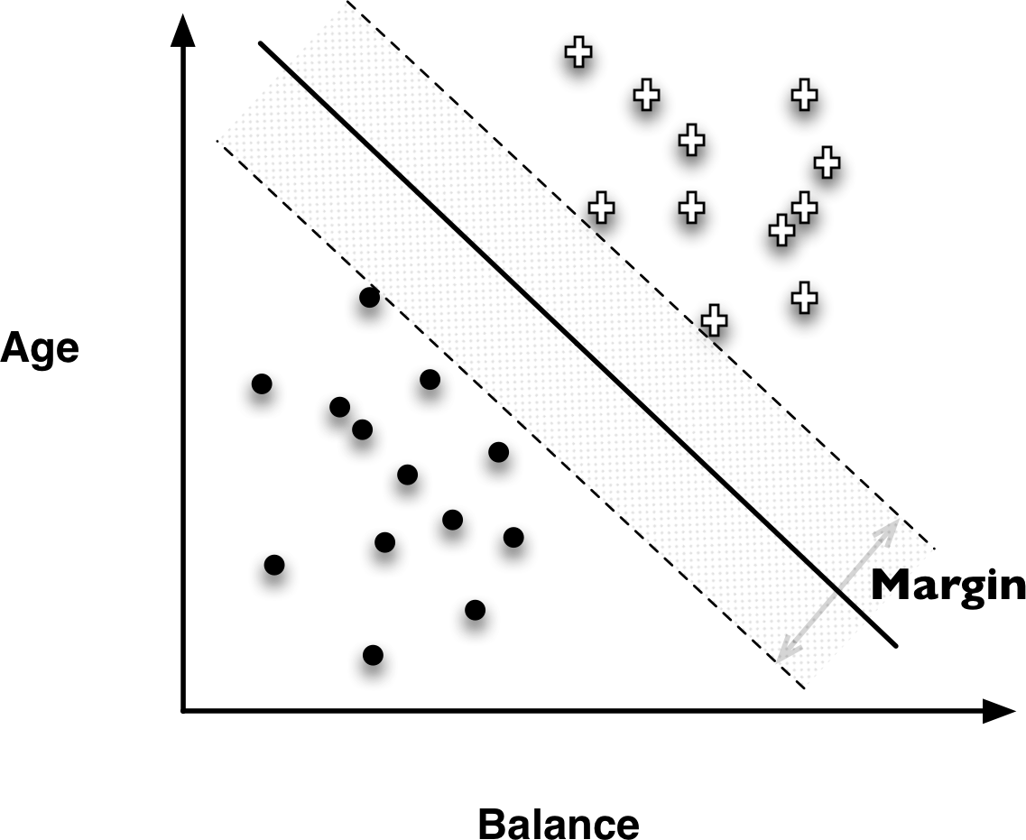
Support Vector Machines (SVMs)

Slide 24
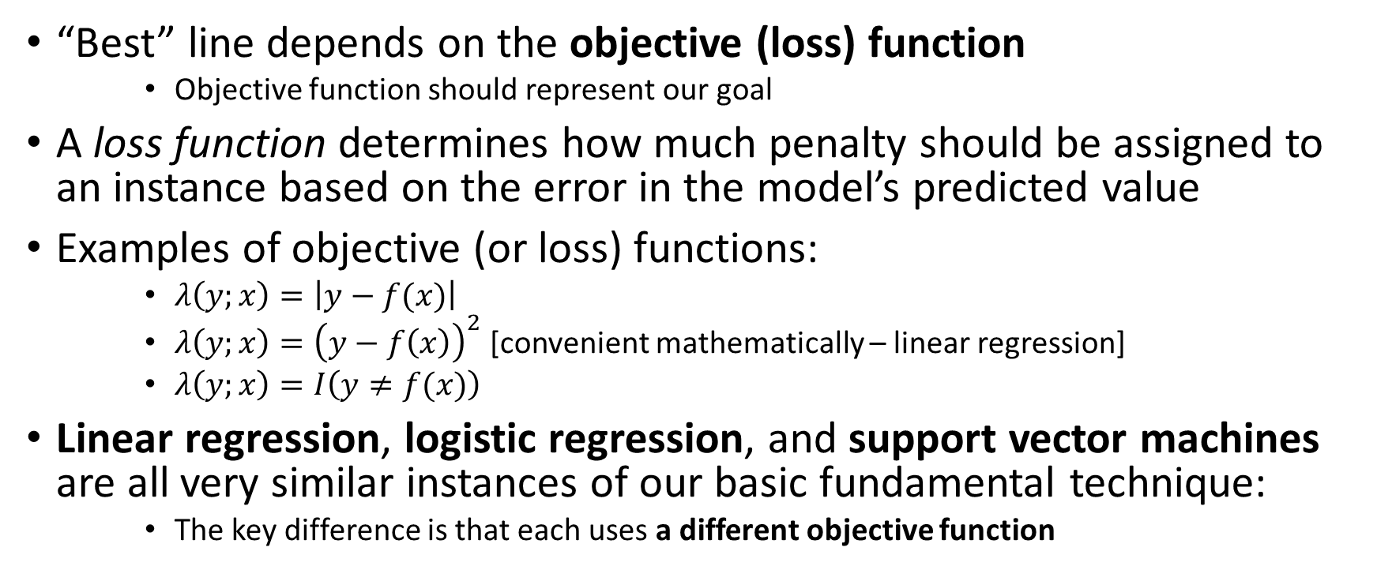
How do linear functions choose their weights? They optimize… Objective Functions
“Best” line depends on the objective (loss) function
Objective function should represent our goal
A loss function determines how much penalty should be assigned to an instance based on the error in the model’s predicted value
Examples of objective (or loss) functions:
$λ\left(y;x\right)=\left|y−f(x)\right|$
$λ\left(y;x\right)={\left(y−f\left(x\right)\right)}^{2}$ [convenient mathematically – linear regression]
$λ\left(y;x\right)=I\left(y≠f(x)\right)$
Linear regression, logistic regression, and support vector machines are all very similar instances of our basic fundamental technique:
The key difference is that each uses a different objective function

Slide 25
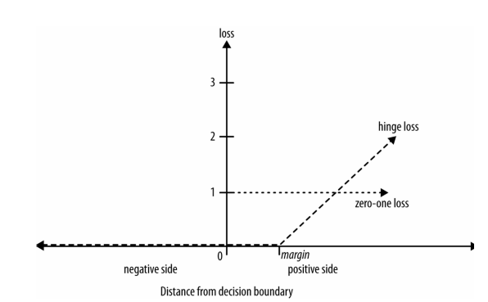
Hinge Loss functions
Support vector machines use hinge loss
Hinge loss incurs no penalty for an example that is not on the wrong side of the margin
The hinge loss only becomes positive when an example is on the wrong side of the boundary and beyond the margin
Loss then increases linearly with the example’s distance from the margin
Penalizes points more the farther they are from the separating boundary

Slide 26
Loss Functions
Zero-one loss assigns a loss of zero for a correct decision and one for an incorrect decision
Squared error specifies a loss proportional to the square of the distance from the boundary
Squared error loss usually is used for numeric value prediction (regression), rather than classification
The squaring of the error has the effect of greatly penalizing predictions that are grossly wrong

Slide 27

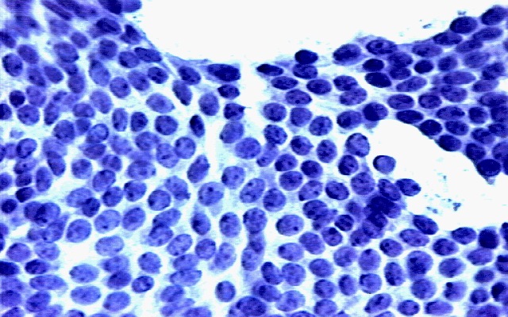
Application of Logistic Regression
The Wisconsin Breast Cancer Dataset
Characteristics of cells. Are they cancerous or not?

Slide 28
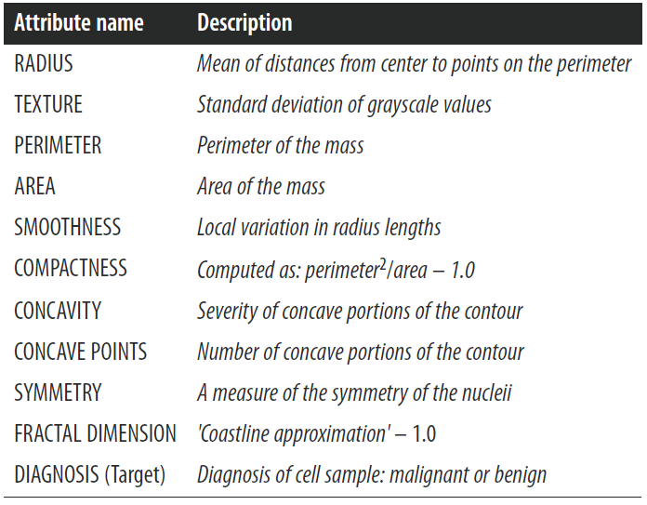
Wisconsin Breast Cancer dataset
Characteristics of cells. Are they cancerous or not?
From each of these basic characteristics, three values were computed: the mean (_mean), standard error (_SE), and “worst” or largest

Slide 29
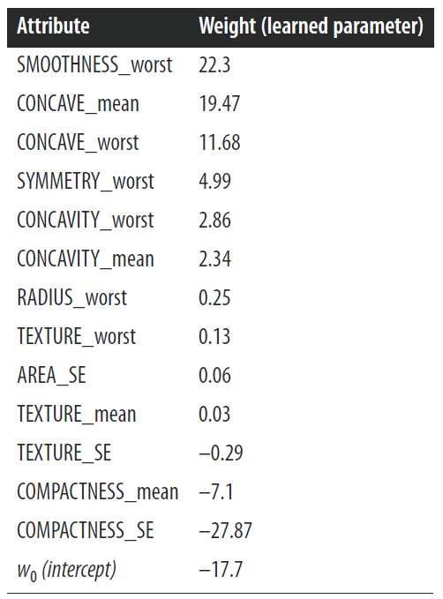
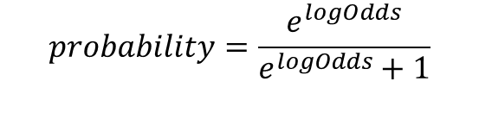
Wisconsin Breast Cancer dataset
The model
$$logOdds=w_{0}+w_{1}∗x_{1}+w_{2}∗x_{2}+ …$$
$$logOdds=−17.7+22.3∗SMOOTHNESS_{worst}+19.47∗CONCAVE_{mean}+ …$$
$$probability=\frac{e^{logOdds}}{e^{logOdds}+1}$$

Slide 30
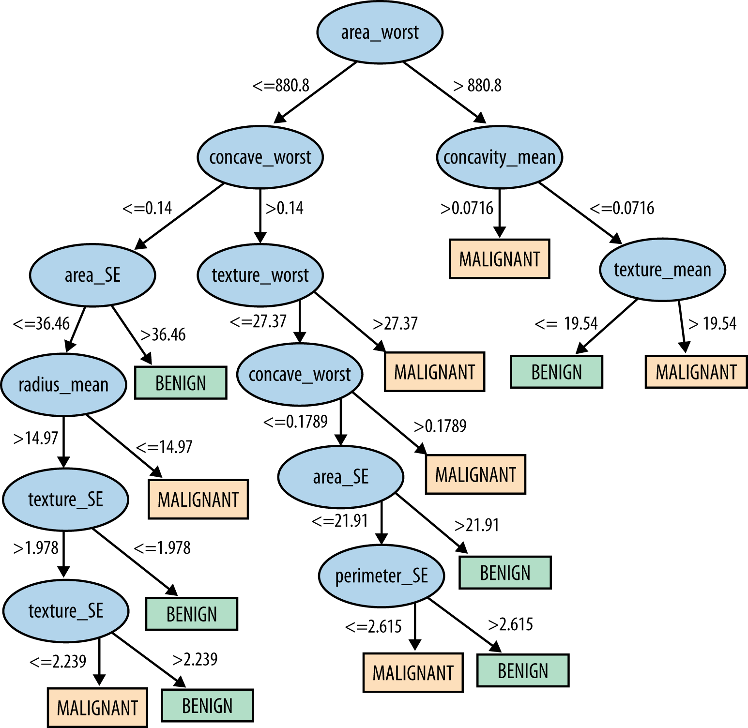
Wisconsin Breast Cancer dataset Modeled with a decision tree…

Slide 31
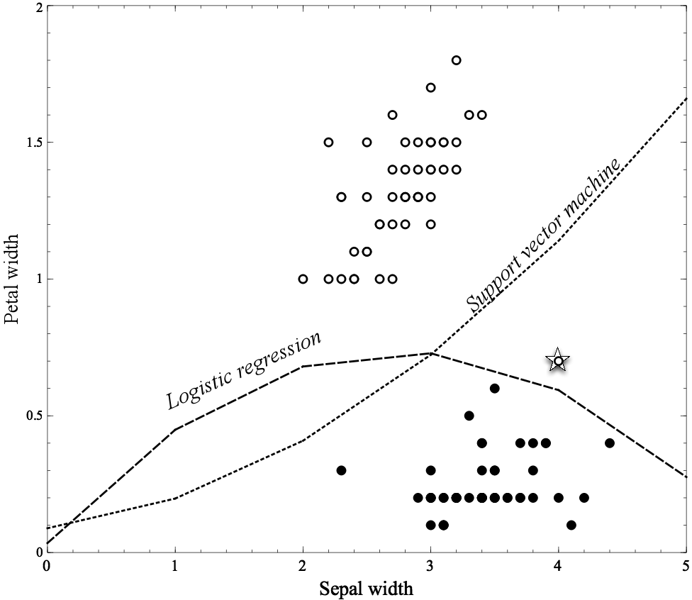
Non-linear Functions
Linear functions can actually represent nonlinear models, if we include more complex features in the functions
like multiplying variables together,
or squaring them,
or taking the log,
etc.

Slide 32
Non-linear Functions
Using “higher order” features is just a “trick”
Common techniques based on fitting the parameters of complex, nonlinear functions:
Non-linear support vector machines and neural networks
Nonlinear support vector machine with a “polynomial kernel” consider “higher-order” combinations of the original features
Squared features, products of features, etc.
Neural networks are non-linear. Think of a neural network as a “stack” of models
On the bottom of the stack are the original features
Each layer in the stack applies a simple model to the outputs of the previous layer
Might fit data too well (..to be continued)

Slide 33
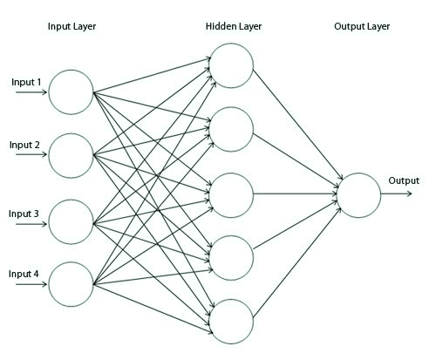
Simple Neural Network
Just a collection of classifiers such as logistic regressions
Each node is a separate classifier

Slide 34
Linear Models versus Tree Induction
What is more comprehensible to the stakeholders?
Rules or a numeric function?
How “smooth” is the underlying phenomenon being modeled?
Trees need a lot of data to approximate curved boundaries
How “non-linear” is the underlying phenomenon being modeled?
If very, much “data engineering” needed to apply linear models
How much data do you have?!
There is a key tradeoff between the complexity that can be modeled and the amount of training data available
What are the characteristics of the data: missing values, types of variables, relationships between them, how many are irrelevant, etc.
Trees fairly robust to these complications

Slide 35
Many figures in this slide deck from Provost, F., & Fawcett, T. (2013). Data science for business: what you need to know about data mining and data-analytic thinking. Sebastopol, Calif.: O'Reilly.

